Slide 1
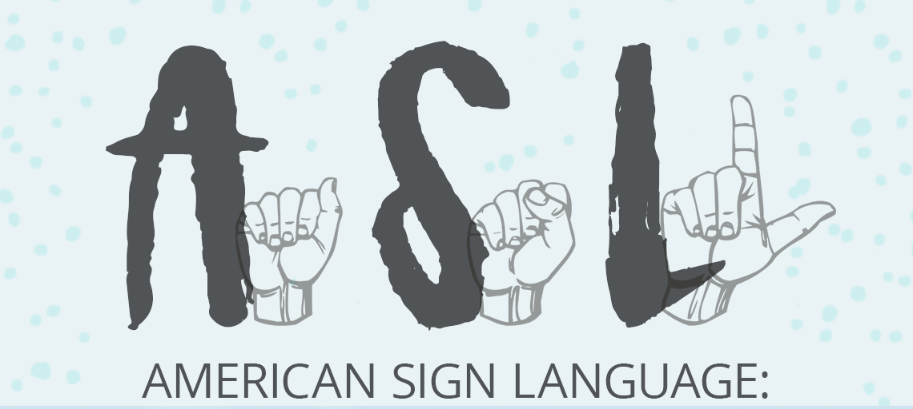
American Sign Language Recognition using Convolution Neural Network
Aditya Gidda Jaswanth Das Gunturu Siddhant Sharma

Slide 2
Introduction
The data contains different images of 5 different people showing the letters a, b, c, d, e, f, g, h and i with their hands.
Our Dataset contains 24,000 .png images.
The data is split into Training Dataset and Test Dataset in the ratio 80:20.
http://empslocal.ex.ac.uk/people/staff/np331/index.php?section=FingerSpellingDataset

Slide 3




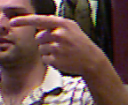
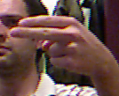



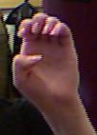

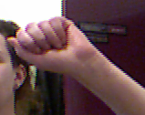

Sample Images

Slide 4
Methodology
Resize all the images to 32X32.
X→ Images
Y→ Labels
Loading the data using MiniBatcher:
Mini-Batcher is being used which is a function that takes the input in batches so that we can iterate through all the divisions.

Slide 5
Convolutional Neural Networks (CNN)
Convolutional Layer
MaxPool
Activation Layer
Fully-Connected Layer
SoftMax

Slide 6
Classification Report
 | Precision | Recall | F1-score | Support
0 | 1 | 1 | 1 | 533
1 | 1 | 0.99 | 0.99 | 547
2 | 1 | 0.97 | 0.98 | 577
3 | 0.99 | 0.99 | 0.99 | 555
4 | 0.98 | 0.99 | 0.99 | 562
5 | 0.98 | 1 | 0.99 | 523
6 | 0.99 | 0.94 | 0.96 | 557
7 | 0.93 | 0.99 | 0.96 | 473
8 | 0.99 | 1 | 0.99 | 534
avg/Total | 0.98 | 0.98 | 0.98 | 4861

Slide 7
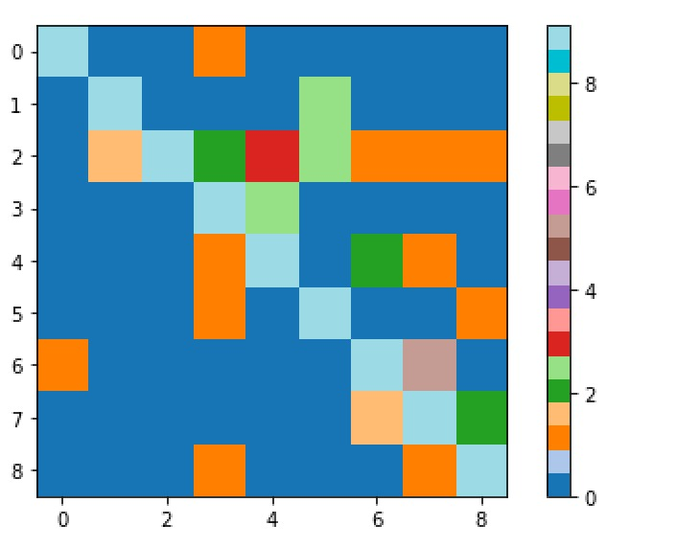
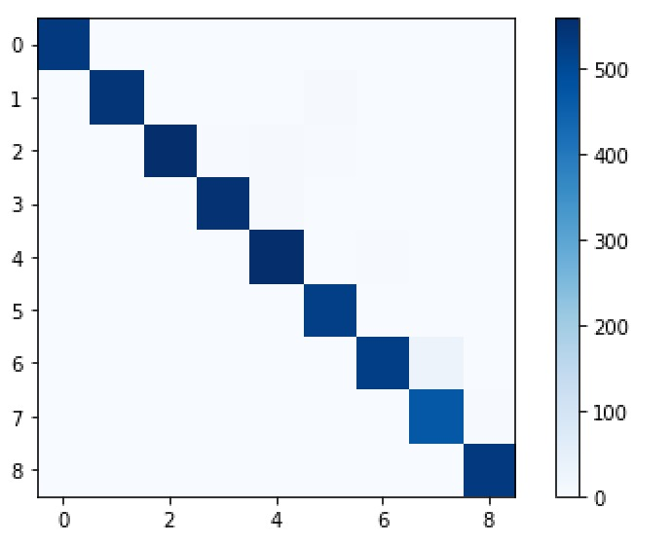
Accuracy Using Color Bars

Slide 8
Confusion Matrix
[[532 0 0 1 0 0 0 0 0]
[ 0 542 0 0 0 5 0 0 0]
[ 0 2 559 3 6 4 1 1 1]
[ 0 0 0 550 5 0 0 0 0]
[ 0 0 0 1 557 0 3 1 0]
[ 0 0 0 1 0 521 0 0 1]
[ 1 0 0 0 0 0 524 32 0]
[ 0 0 0 0 0 0 2 468 3]
[ 0 0 0 1 0 0 0 1 532]]
Accuracy: 0.984365356922444 i.e., 98.43%

Slide 9
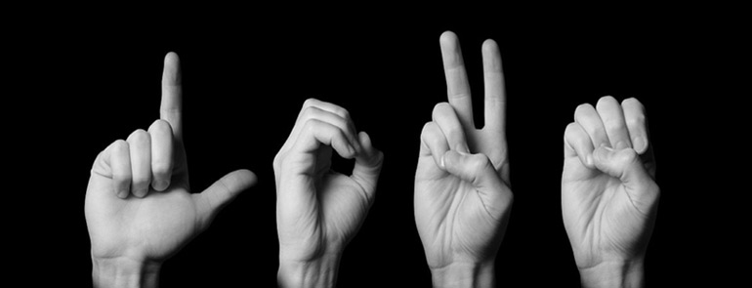
Thank You

